Slide 1

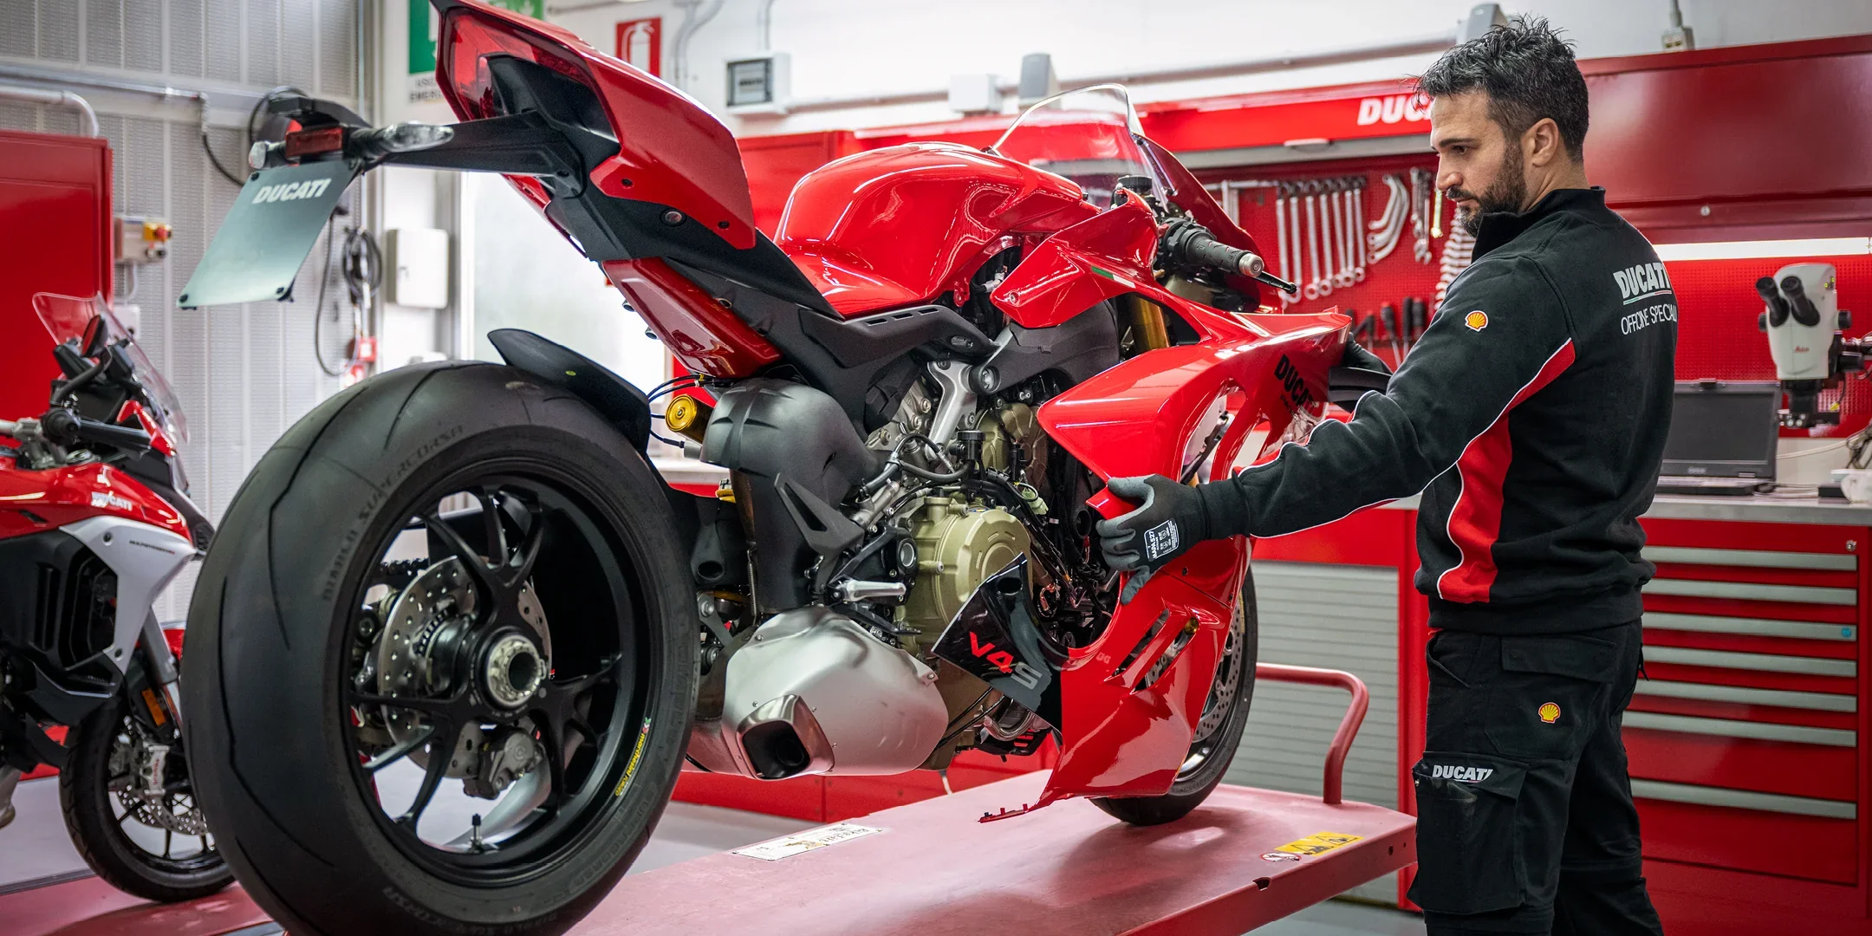
BikeDoctor
KNOW-IT CDAC-ACTS (ATC),PUNE
Under Guidance Of:- Ms. Snehal Somvanshi
Project members:
Akash Bodkhe (230343020018)
Deepak Kumar Singh (230343020025)
Aniket Khavnekar (230343020046)
Rutvij Mahamuni (230343020053)

Slide 2
Project Introduction
Purpose of BikeDoctor
Need of BikeDoctor
Who are going to be benefited from BikeDoctor?

Slide 3



Project Architecture
FRONT-END
Technologies used:
Springboot
ASP .Net
BACK-END
Technologies used:
ReactJS
Bootstrap
Technologies used:
MySQL
MIDDLEWARE

Slide 4
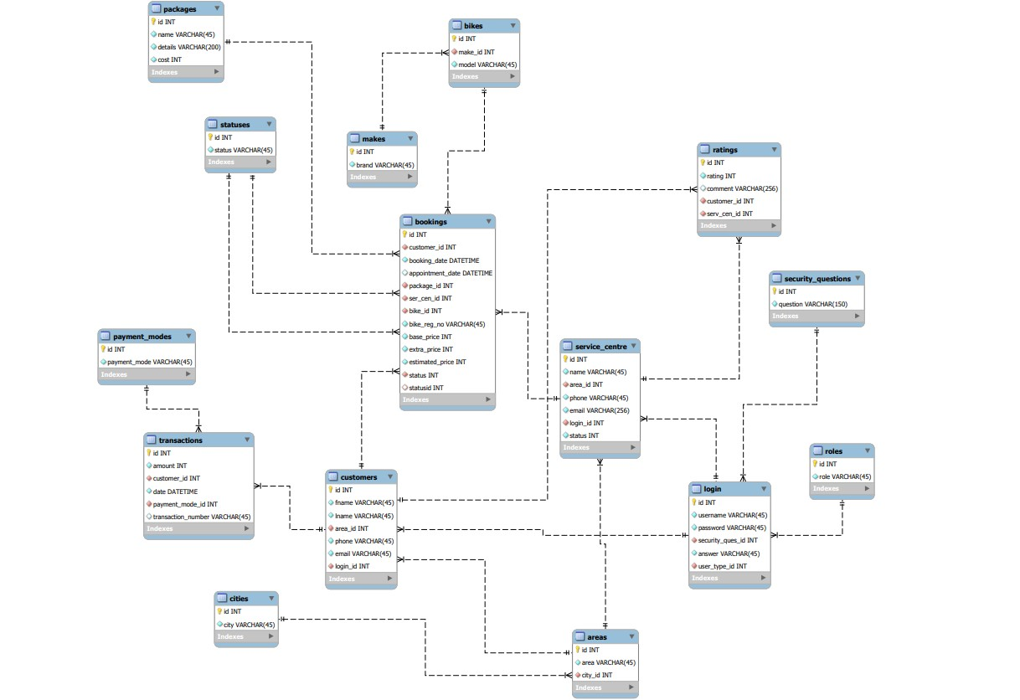
Database Design

Slide 5
Technologies Used
Front-End: ReactJS, Bootstrap
Middleware: Springboot Framework, ASP .Net
Back-End: MySQL

Slide 6
Why ReactJS?
Component Based Architecture
Virtual DOM
Reusable Components
Compatibility

Slide 7
Why Springboot and .Net?
Springboot:
Java Ecosystem
Dependency Injection
Large support for tools and libraries
.Net:
Integrated Developers Environment
Performance
Entity Framework

Slide 8
Why MySQL
Open Source
Cross Platform compatibility
Wide Language Support
Stored Procedures and triggers

Slide 9
Users of BikeDoctor and responsibilities
Customers
Service Centres
Admin

Slide 10
Customer
Role:
Booking the appointment for their motorcycles servicing
Responsibilities:
Registration
Login
Booking an appointment for specific date
Checking the progress and estimated cost
Paying through the portal
Reading blogs
Ratings

Slide 11

REGISTRATION
LOGIN
BOOK APPOINTMENT
CHECK PROGRESS
CUSTOMER
PAYMENT
RATINGS

Slide 12
Service Centre
Role:
Accepting the bookings and updating the data for customer
Responsibilities:
Registration
Login
Viewing all bookings for them
Updating the work status
Updating the transaction details

Slide 13
REGISTRATION
LOGIN
VIEW BOOKINGS
SERVICE CENTRE
UPDATE STATUS
VIEW TRANSACTIONS

Slide 14
Admin
Role
Monitoring the entire system with administrative rights
Responsibilities:
Login
View all customers
View all service centres
Approve registration of new service centres
View all transactions
View all bookings
View all ratings
Revoke the registration of any customer/service centre

Slide 15
LOGIN
VIEW CUSTOMERS
VIEW SERVICE CENTRES
APPROVE REGISTRATIONS
VIEW TRANSACTIONS
ADMIN
VIEW BOOKINGS
REVOKATIONS

Slide 16
Work division and contributions
Akash:
Database design
Backend and frontend for customer
Managing Github
Aniket:
Backend and frontend for admin
Frontend assistance for service centre
Deepak:
Backend and frontend assistance for Service centre
Blogs and other static pages
Rutvij:
Database design
Backend and frontend for service centre
Managing Github

Slide 17
GitHub
GitHub Repository URL:
https://github.com/bodkheAkash/BikeDocter
GitHub branches:
https://github.com/bodkheAkash/BikeDocter/tree/akash
https://github.com/bodkheAkash/BikeDocter/tree/deepak
https://github.com/bodkheAkash/BikeDocter/tree/Aniket
https://github.com/bodkheAkash/BikeDocter/tree/Rutvij

Slide 18
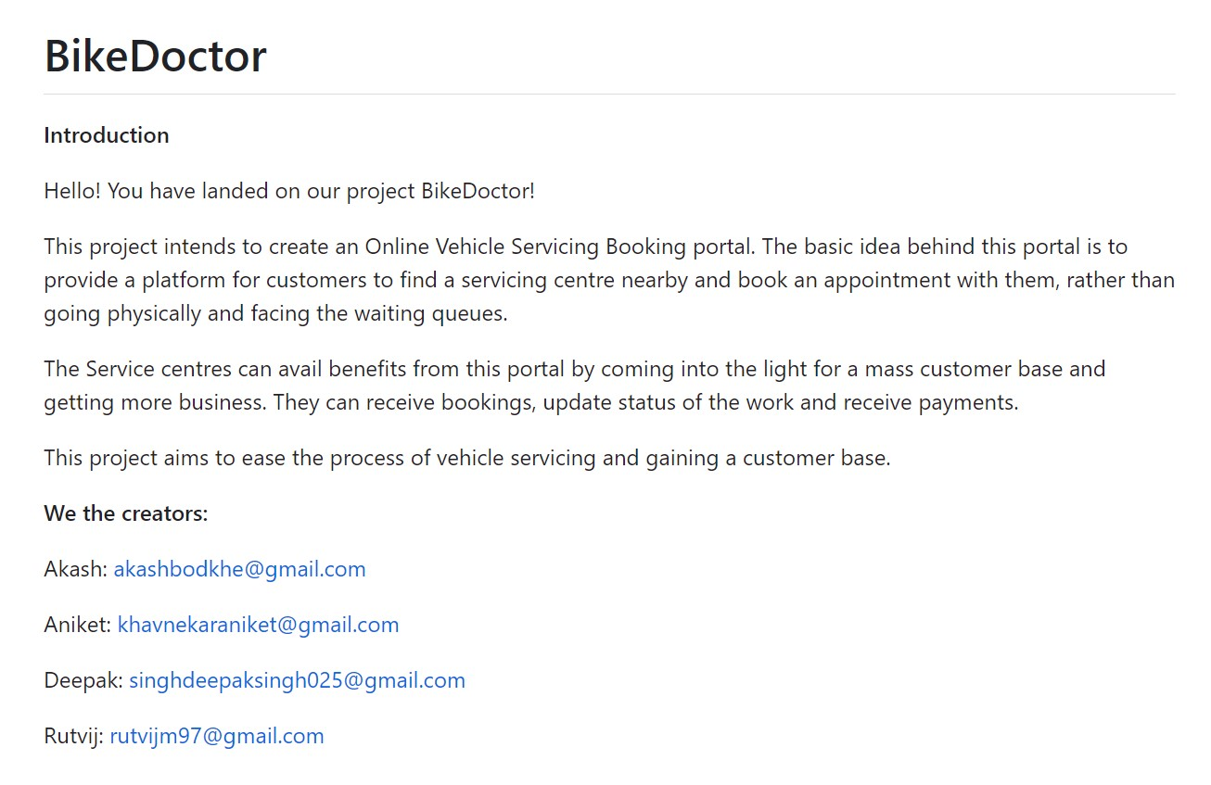

Slide 19
Future Extensions
Ability of service centres to generate appointment slots
Ability for customers to select appropriate appointment slots
Dynamicity for blogs

Slide 20
What did we learn?
Practical Implementation of the technologies
Creating an application from business concept
Distribution of work and productive team work

Slide 21
THANK YOU!!
ANY QUESTIONS???

